Slide 1
Getting Started with the Spectrum Scale REST API — Andreas Koeninger Scrum Master and Developer Spectrum Scale GUI and REST API

Slide 2
Contents
Overview 03
What is a REST API? 04
Four basic operations 05
Getting Started with the Spectrum Scale REST API 06
Architecture 07
Sample Calls 10
Endpoints 11
Demo 17

Slide 3
What is a REST API?
“REST API”
“Representational State Transfer”
Neither a protocol nor a standard → Every API is different
Some loose conventions, for example:
Hierarchical URLs to identify entities, e.g.: /filesystems/gpfs0/filesets
Stateless
Client always sends all the data the server needs to fulfill a request
Easy to use and implement since no state has to be managed
On the CLI: curl
Python, Java, …
HTTP/HTTPS
Well-known and wide-spread protocol
HTTP security features can be leveraged, e.g. encryption, authentication, …
URLs are used to identify entities
Four basic HTTP methods:
POST, PUT, GET, DELETE
JSON/XML
Data is returned in machine readable format, for example JSON (JavaScript Object Notation) or XML (Extensible Markup Language)
Easy to read and debug

Slide 4
Four basic operations
Create – POST
Create new entities asynchronously
Example: Create a new fileset or SMB share
Read – GET
Retrieve information about all entities or a specific entity
Returned entities can be filtered
Example: List all unhealthy nodes
Update – PUT
Change the configuration or state of an entity
Example: Change an ACL or unmount a filesystem
Delete – DELETE
Remove an entity
Example: Delete a threshold or NFS export

Slide 5
Getting Started with the Spectrum Scale REST API
Architecture 07
Sample Calls 10
Endpoints 11

Slide 6
Architecture (1/3)
Requests are served over HTTPS
Any client application can easily access the REST API (curl, Python, Java, …)
Uses the same software stack as the GUI
→ Multiple instances are supported for HA
GUI user and role management is used
→ Local users or users in an external AD/LDAP server are supported
Data is cached in a local database
Cached data is updated via events coming from GPFS and on periodic intervals

Slide 7
Architecture (2/3)
Experienced Storage Admins
New non-technical Users
Custom Monitoring
Custom Configuration
GUI Frontend
REST API
DB
GUI Backend Layer
Custom Management
GPFS
GNR (ESS, Lenovo, DDN)

Slide 8
Architecture (3/3)
Four basic operations:
POST, PUT, GET, DELETE
GET requests are always served from the local database
Returned entities can be filtered (e.g. all filesets starting with research*)
Returned fields can be filtered
POST, PUT, DELETE requests are always asynchronous
A jobId is returned which can be used to track the progress
sysout, syserr, rc, .. of the mm-command can be retrieved

Slide 9
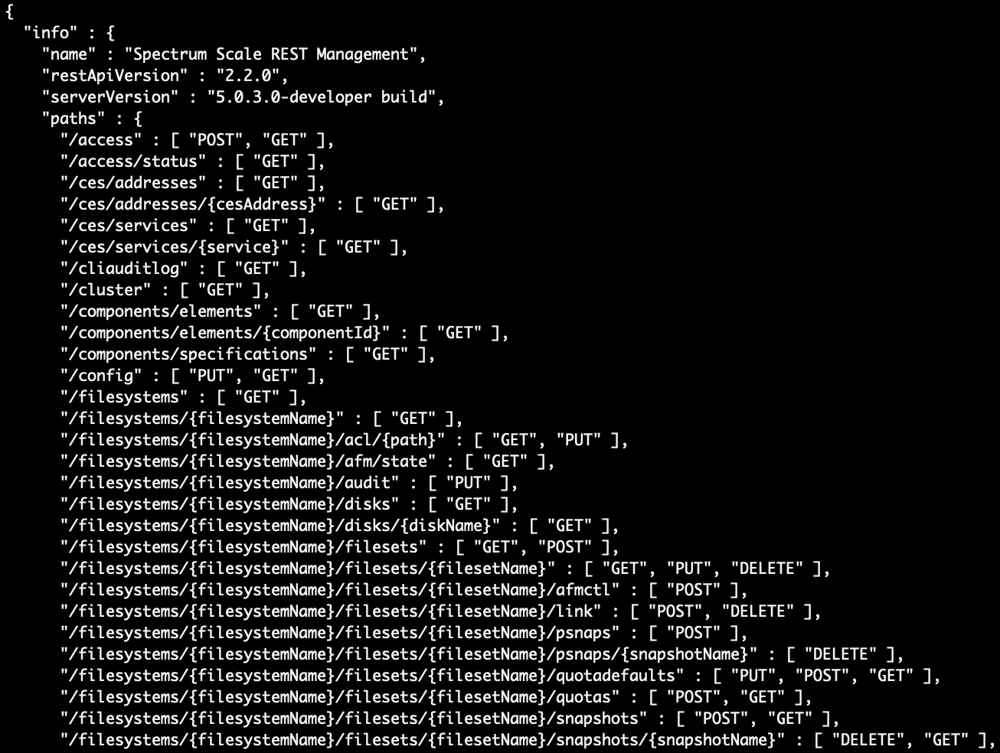
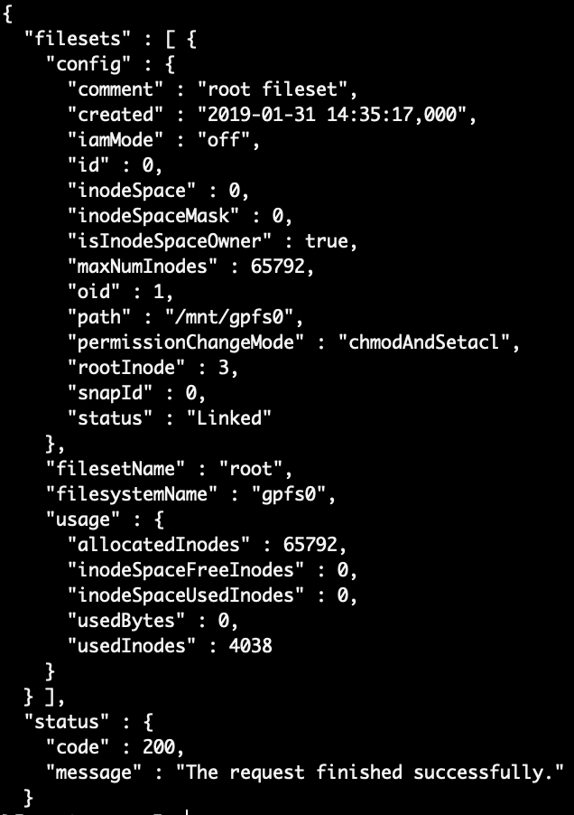
Sample Calls
List all endpoints:
curl -u 'admin:admin001' -X GET -k https://localhost:443/scalemgmt/v2/info
List all filesets in filesystem:
curl -u 'admin:admin001' -X GET -k https://localhost:443/scalemgmt/v2/filesystems/gpfs0/filesets?fields=:all:

Slide 10
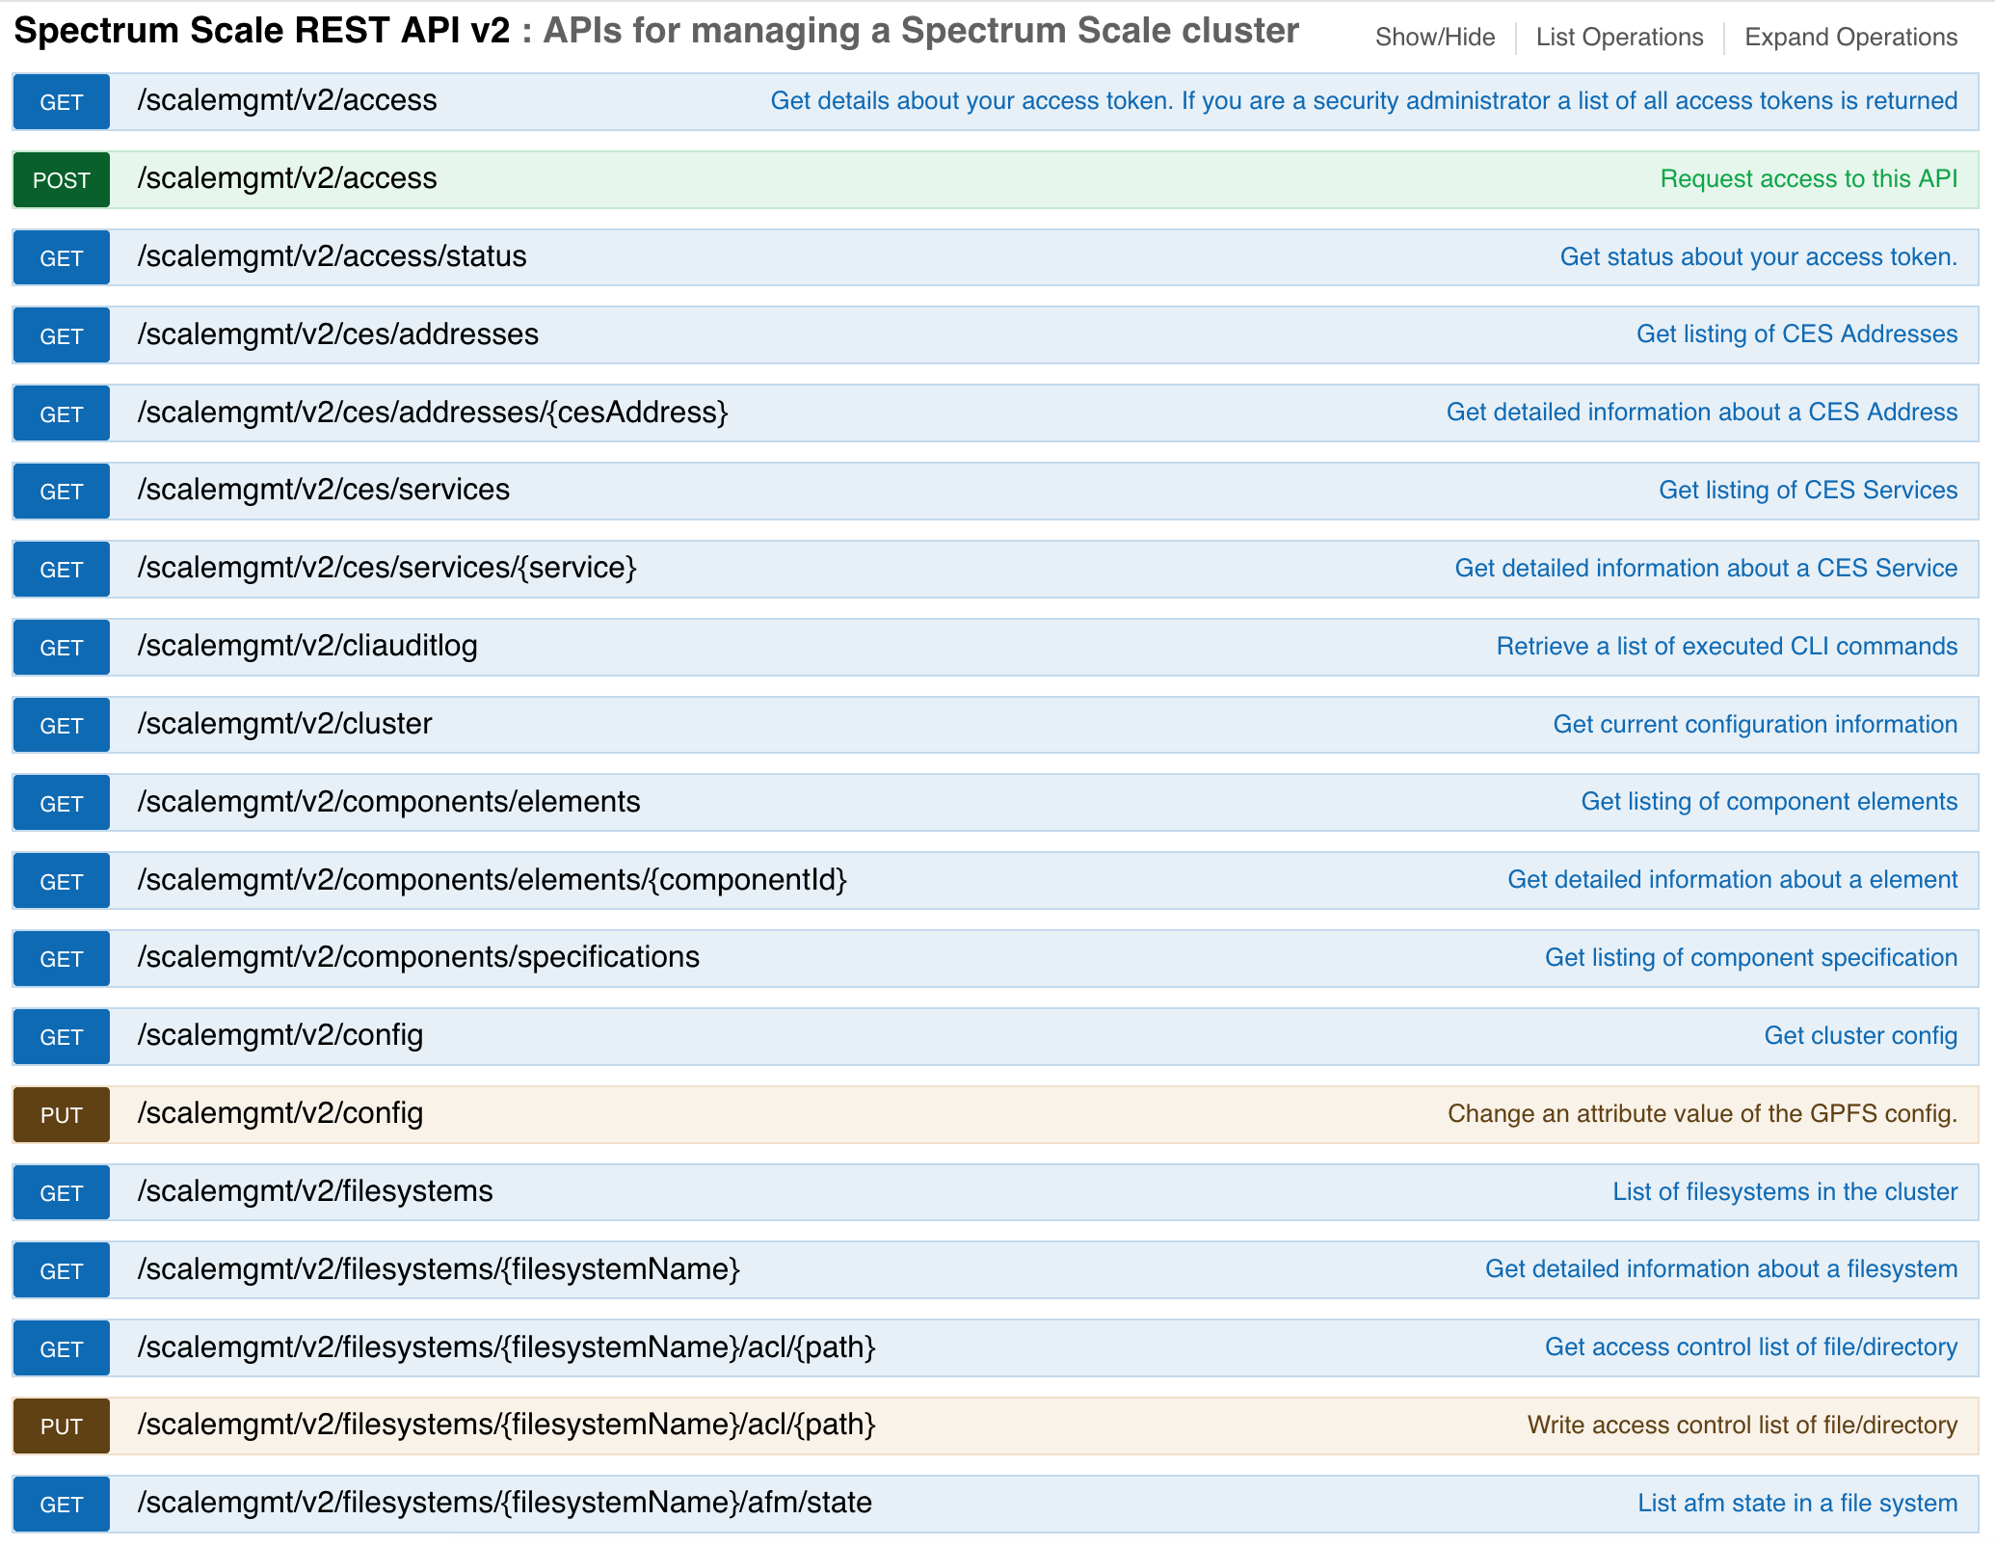
Endpoints (CES, File Systems, ACLs, …)

Slide 11
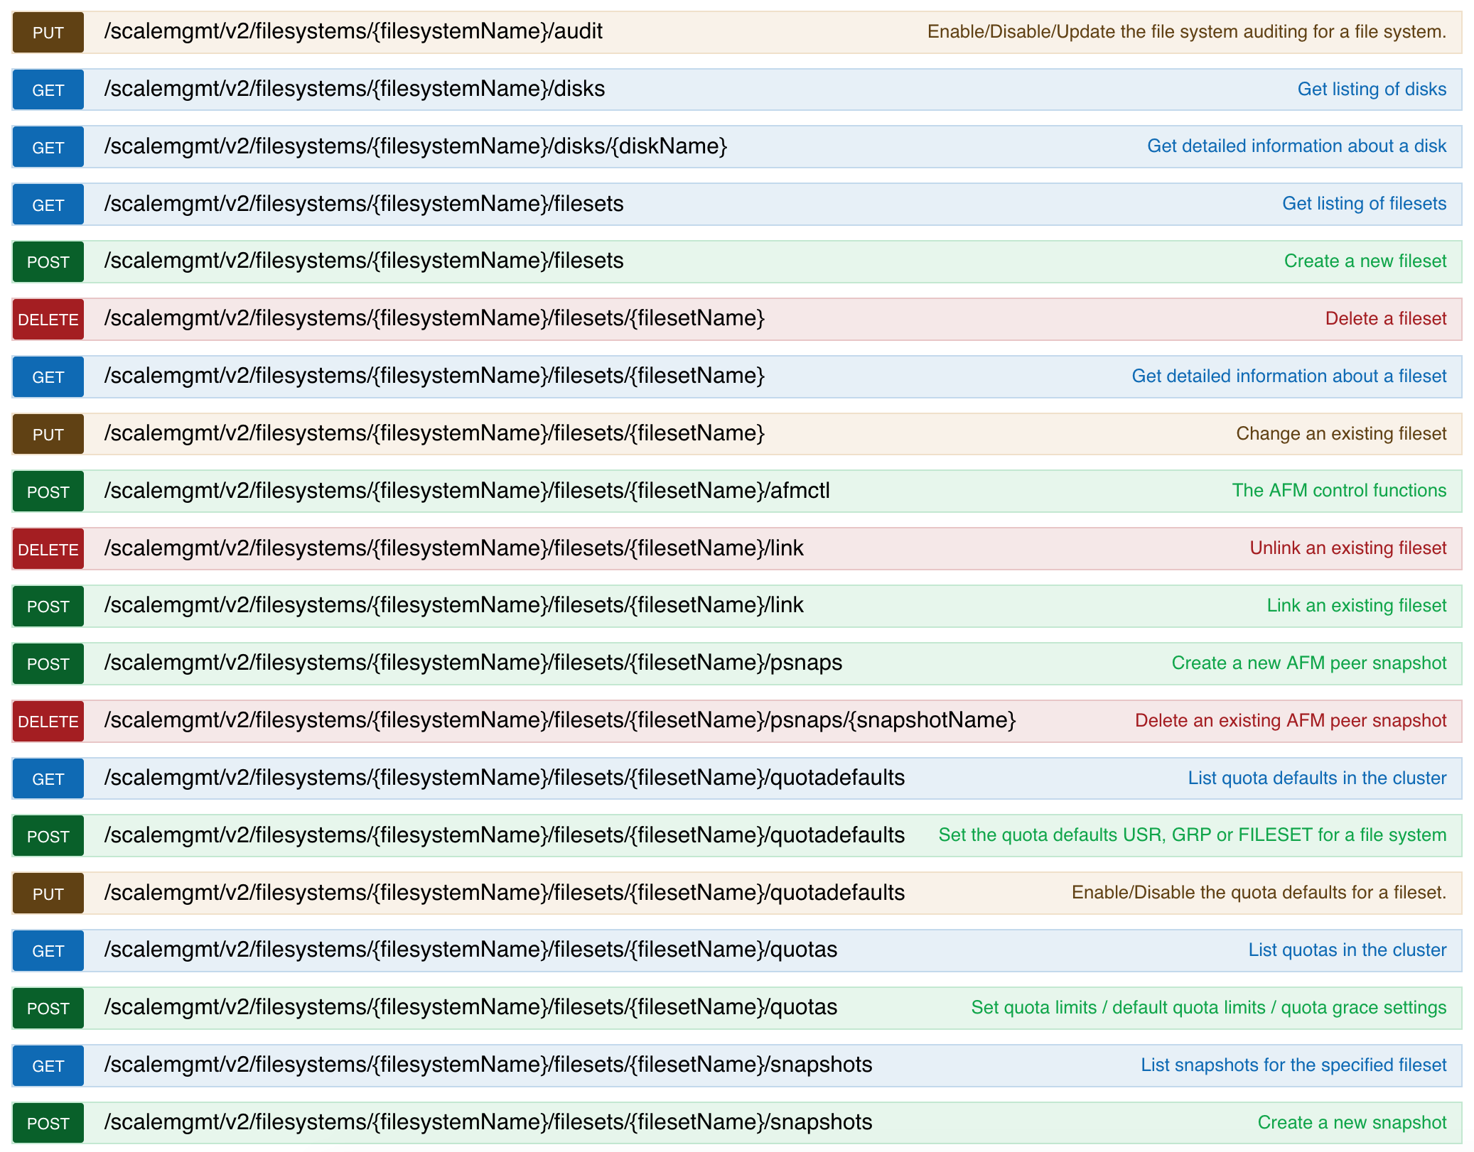
Endpoints (Disks, File Sets, Quotas, …)

Slide 12
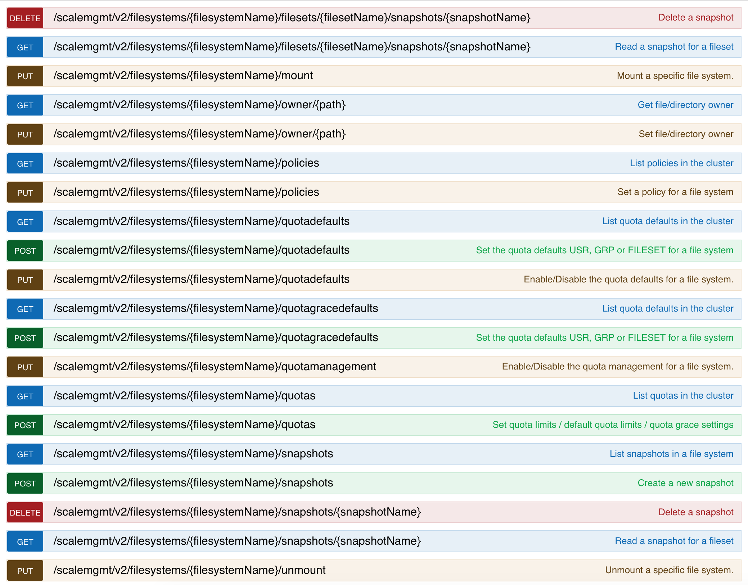
Endpoints (Policies, Snapshots, …)

Slide 13
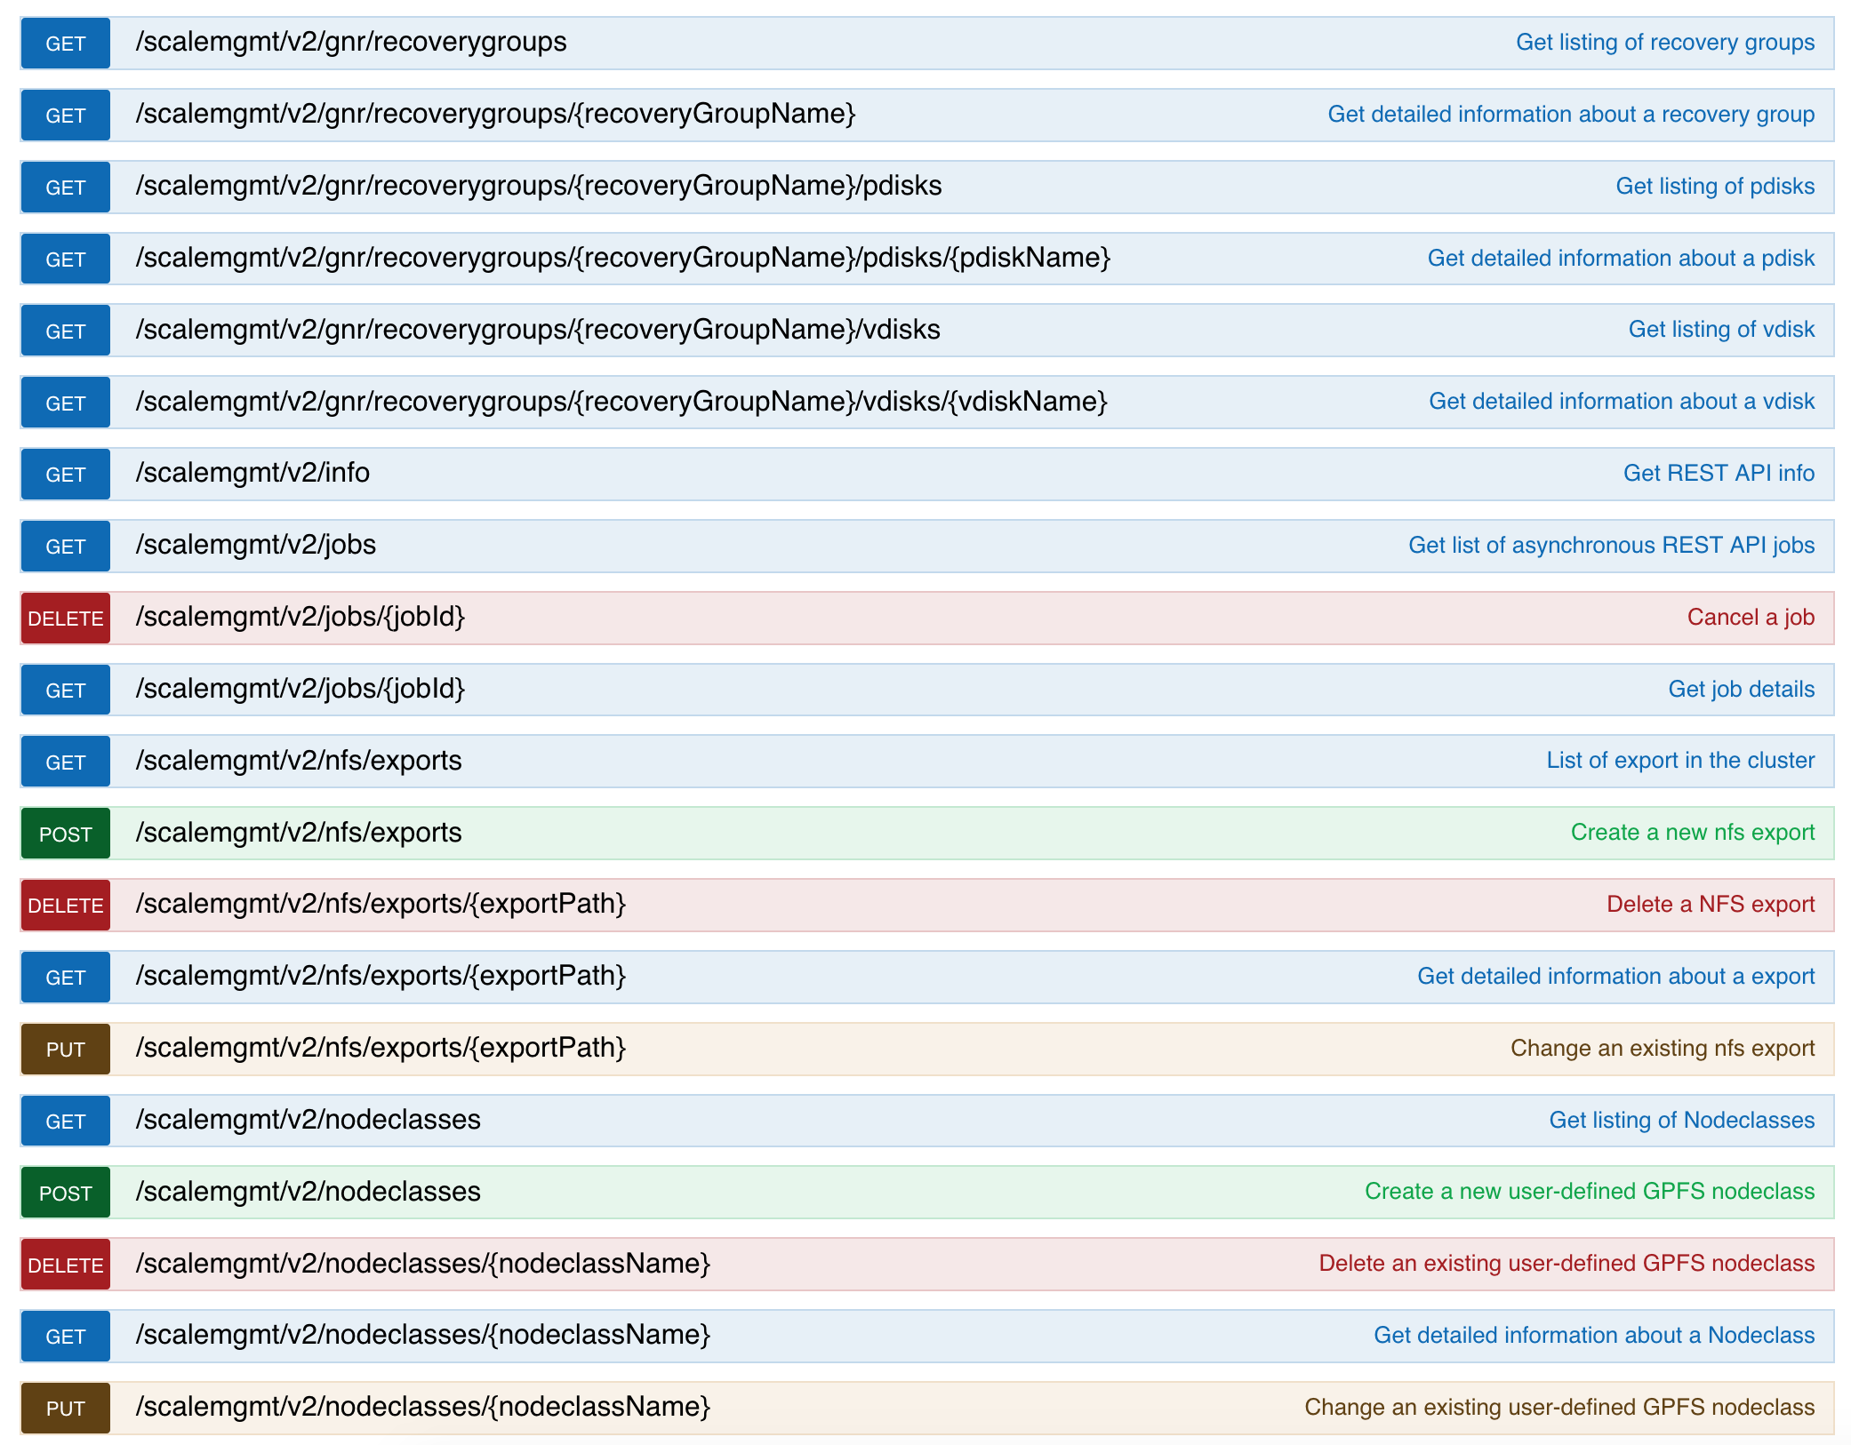
Endpoints (RGs, NFS exports, Node Classes, …)

Slide 14
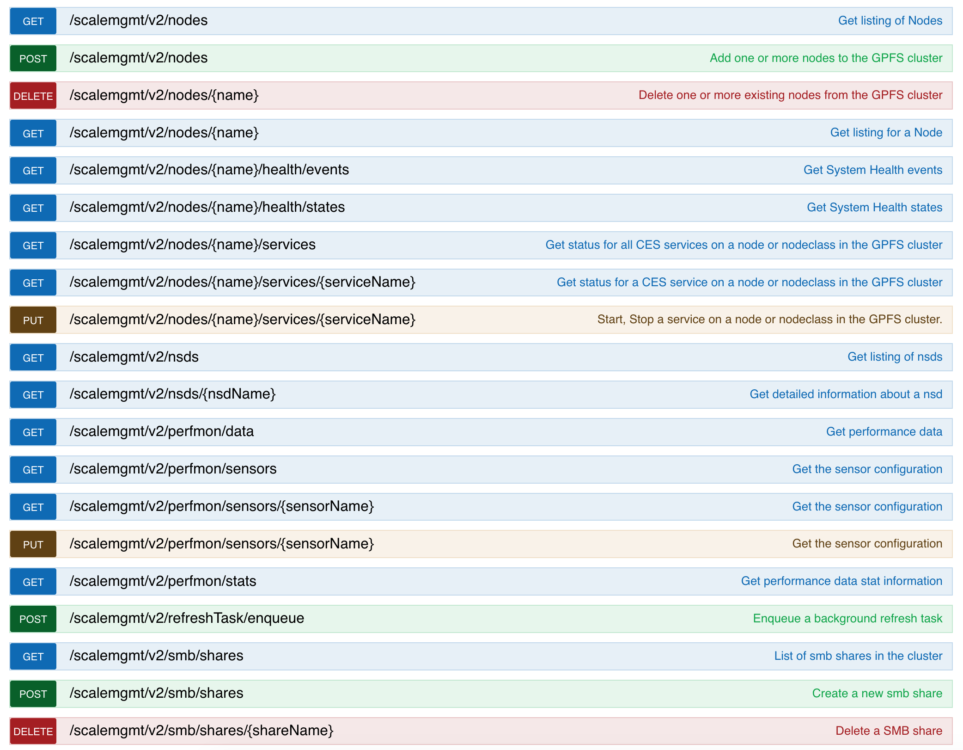
Endpoints (Health Data, Performance Monitoring, …)

Slide 15
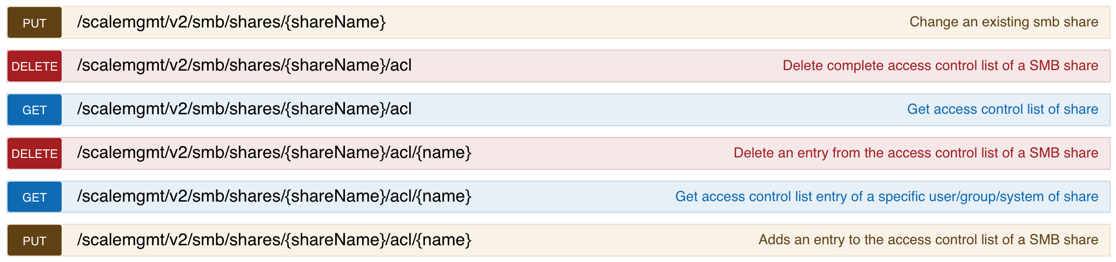
Endpoints (SMB Shares, …)

Slide 16
Hello Mr. Storage Admin, I need storage space for our new research project. Can you help me?
Sure!

Slide 17

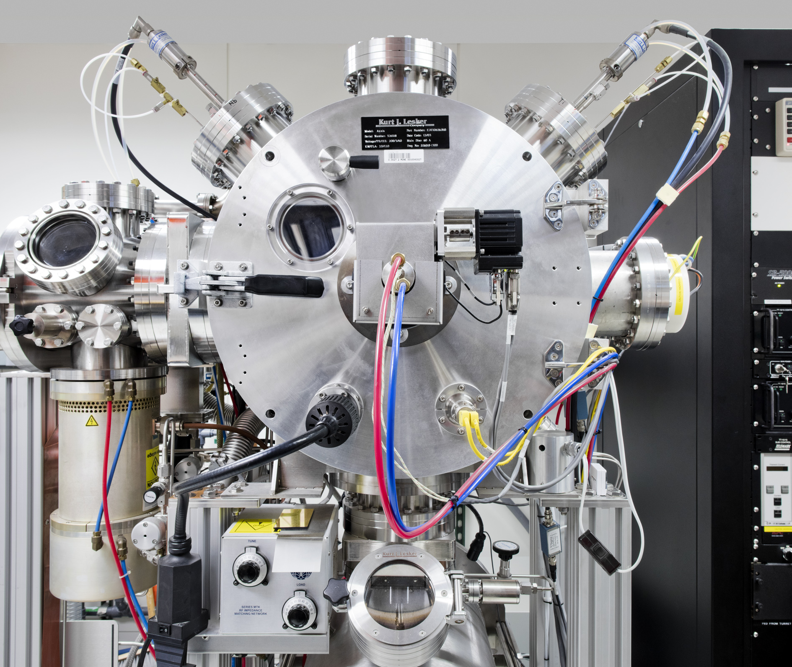
Demo (GitHub: https://github.com/andiveloper/spectrumscale-guides)

Slide 18
Thank you
Andreas Koeninger
Scrum Master and Developer
Spectrum Scale GUI and REST API
—
andreas.koeninger@de.ibm.com
GitHub: https://github.com/andiveloper/spectrumscale-guides
LinkedIn: https://www.linkedin.com/in/andreas-k%C3%B6ninger-9a465283/

